Slide 1
Visualization of 3D Printed FDM model
Sambit Ghadai

Slide 2
OBJECTIVE
To model and simulate a layer by layer 3D printed Fused Deposition Model using OpenGL.
To visualize each layer of the “as-manufactured” 3D FDM model.

Slide 3
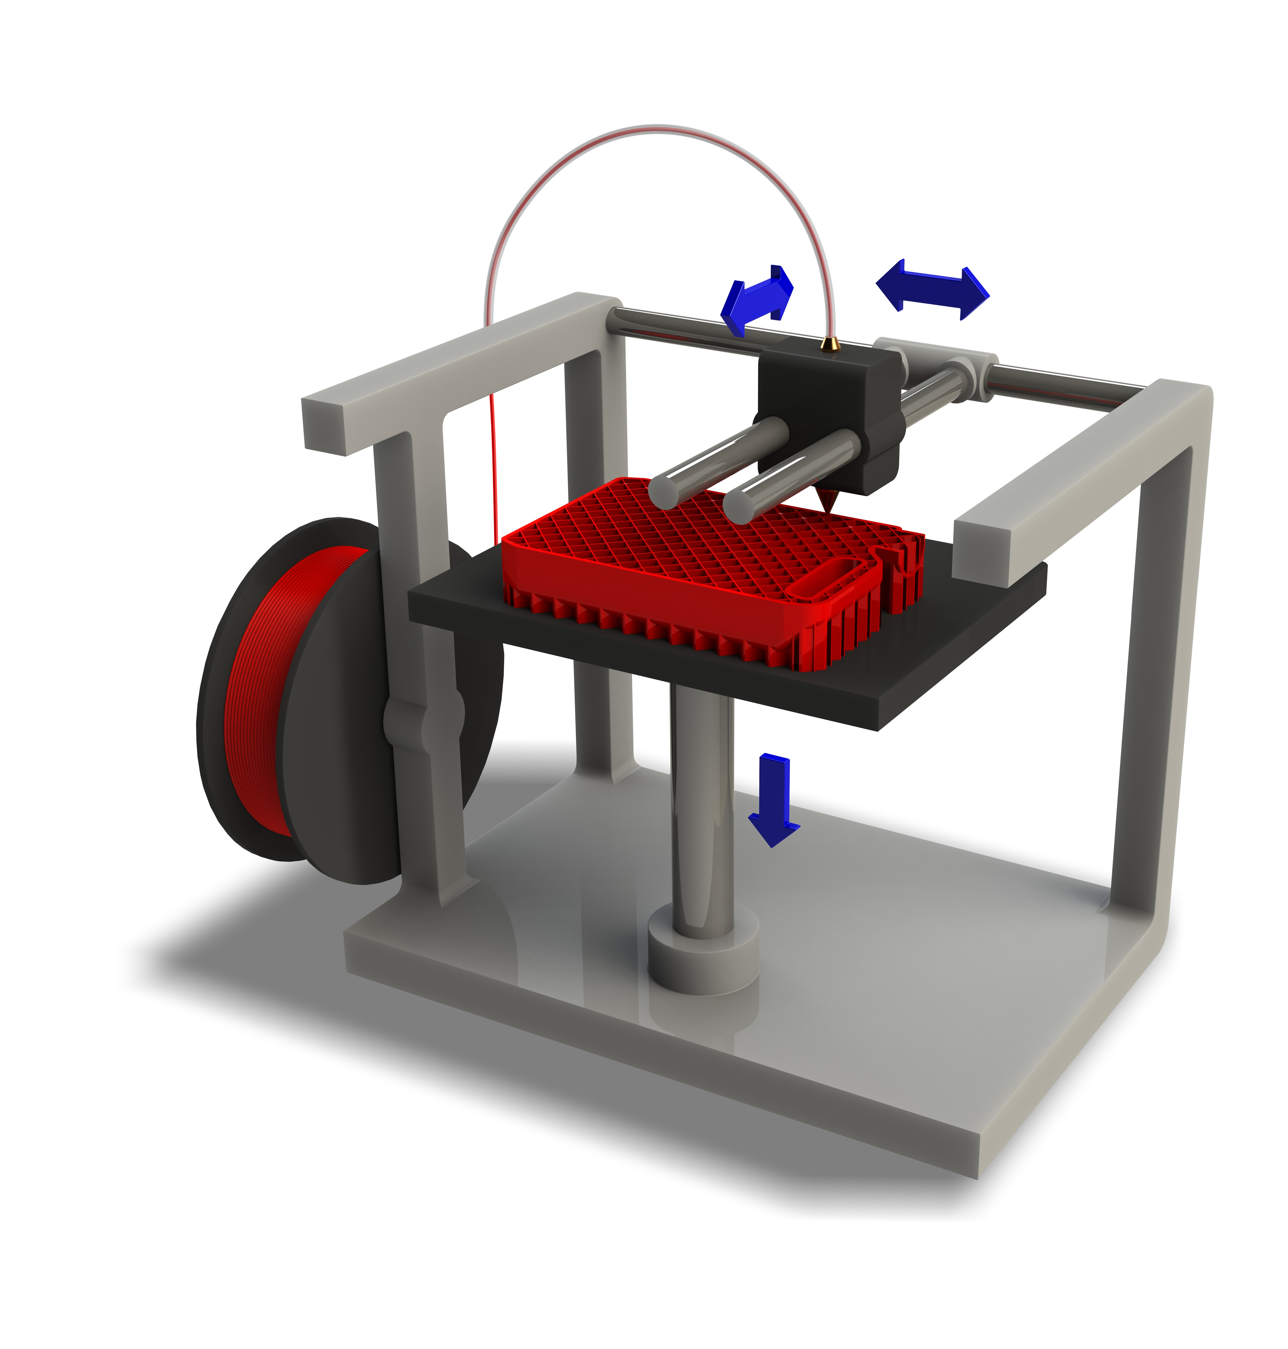
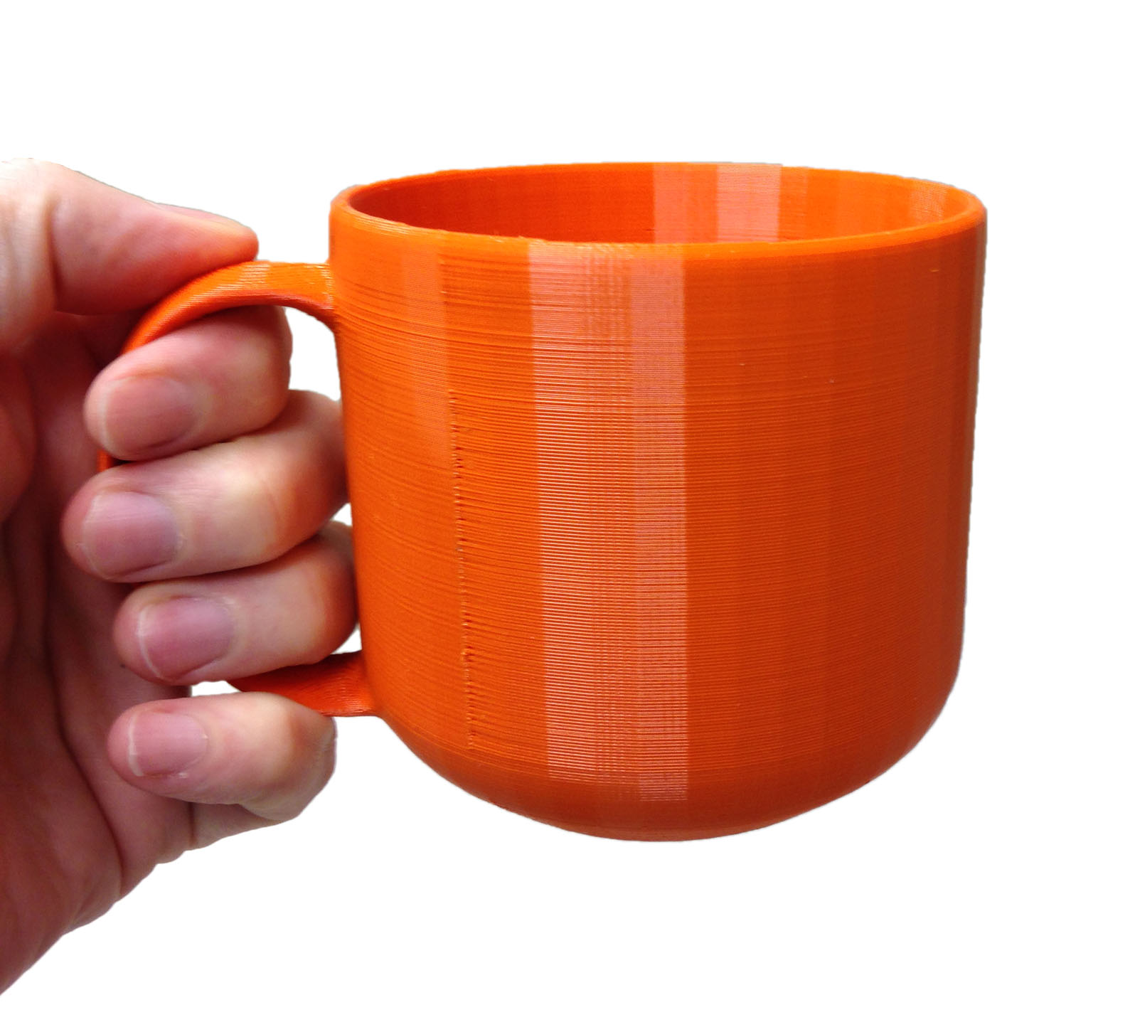
INTRODUCTION
Fused Deposition Model
Notes:
Additive manufacturing technology that lays down materials layer by layer.

Slide 4
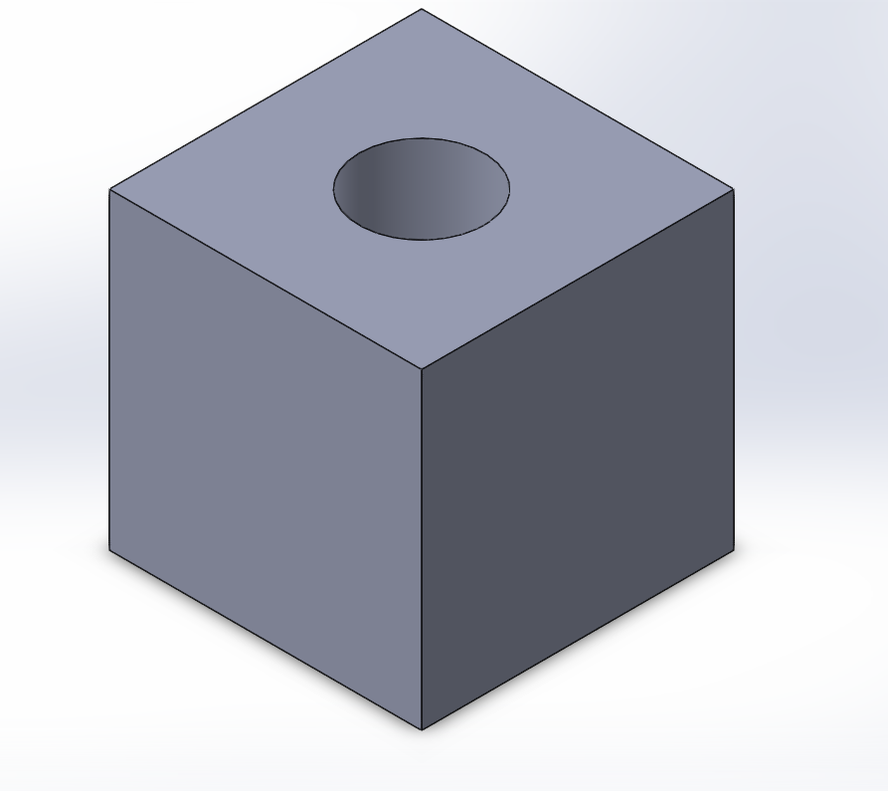
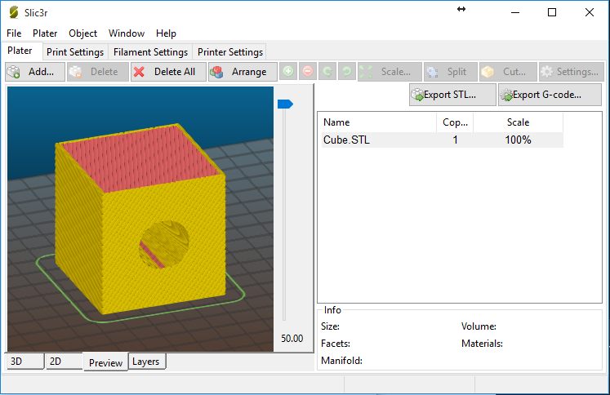
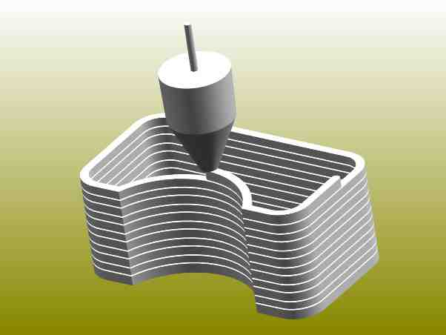
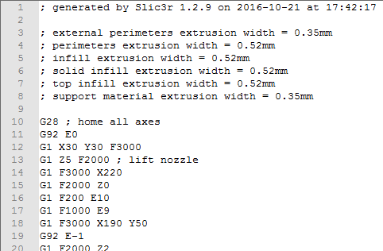
FDM 3D Printing Process
3D Model to SLIC3R
G-Code to 3D Printer
3D Printing from
G-Code

Slide 5
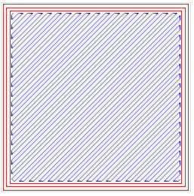
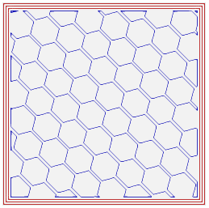
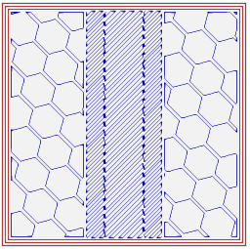
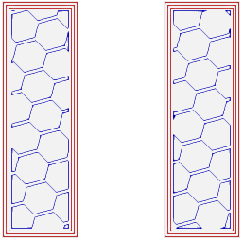
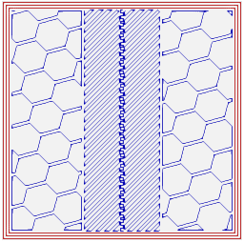
2D Layered Information
1
2
3
4
5
6

Slide 6
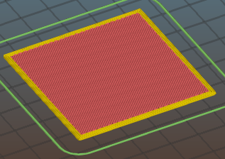
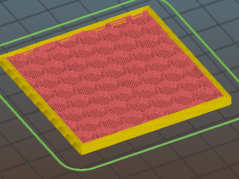
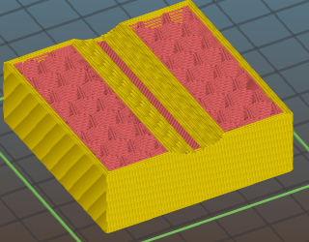
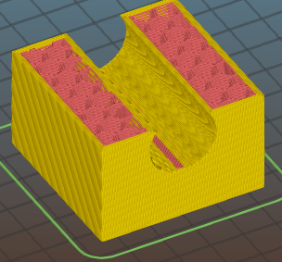
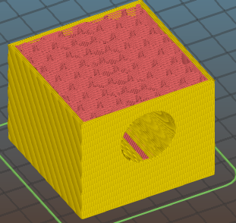
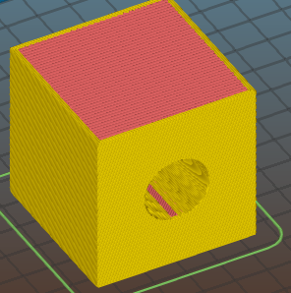
3D Layered Information

Slide 7
LAYOUT
Convert the layer information to a solid model using ACIS
Extract the triangulated data, normals and vertex coordinates in .OBJ file
Read G-Code and save Line & Layer information
Current Stage
Arrange layers on top of one another and assign Key combinations to control the motion of the layers
Assign Textures, Lighting, building the environment
Input the .OBJ files to OpenGL program and make a model for each layer
Assign Camera controls to zoom, rotate and pick a layer for viewing

Slide 8
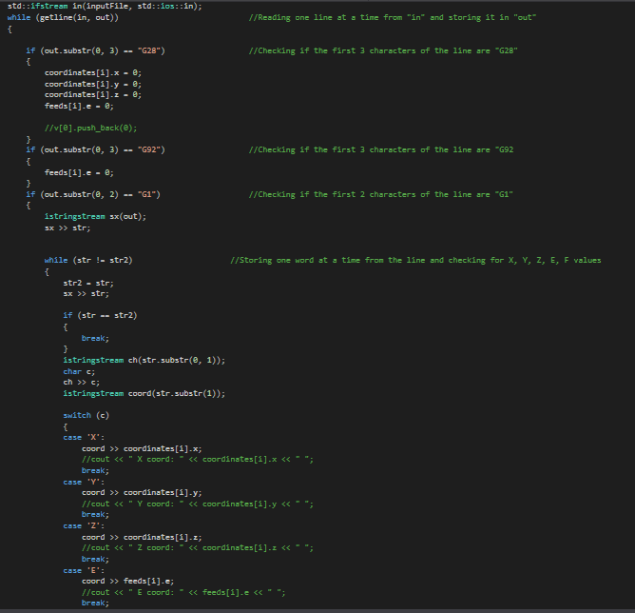
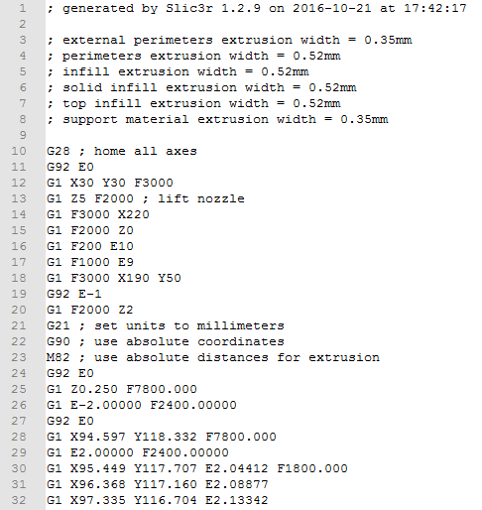
STEP 1
Read G-Code and save Line & Layer information
G-Code
Code Snippet

Slide 9
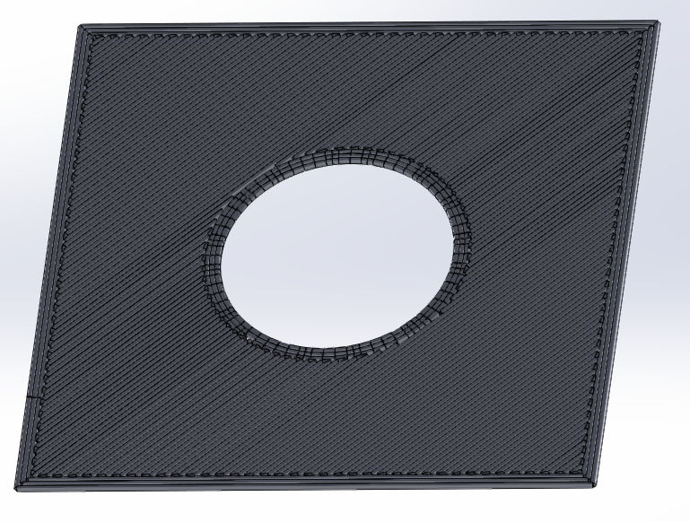
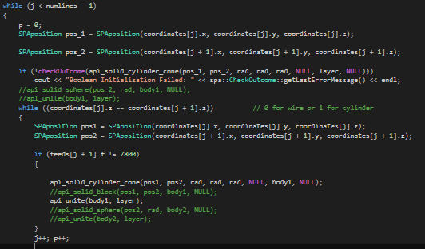
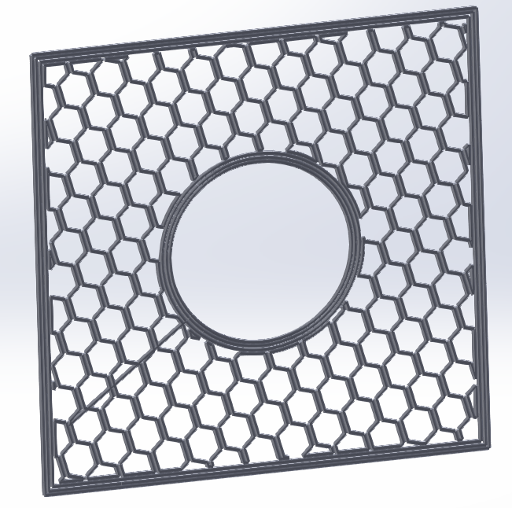
STEP 2
Convert the layer information to a solid model using ACIS
Layers

Slide 10
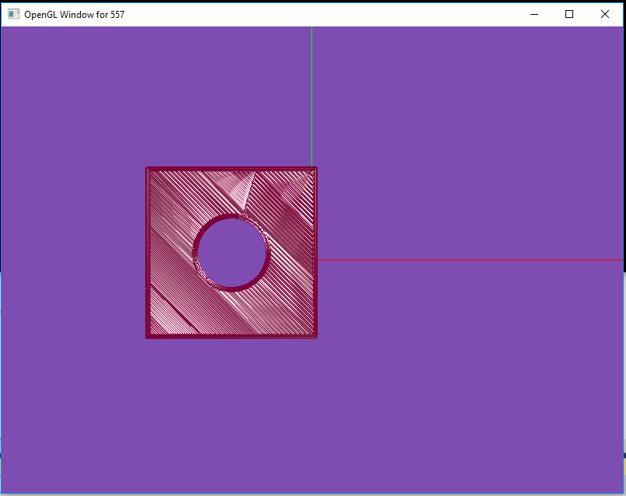
STEP 3 & STEP 4
Each layer information is stored in an Object (.obj) file
This contains all the triangulated data for the vertices, faces, normals and the texture vertices.
The Object files are then read in the OpenGL program to generate a model for each layer.
Extract the triangulated data, normals and vertex coordinates in .OBJ file
Input the .OBJ files to OpenGL program and make a model for each layer

Slide 11
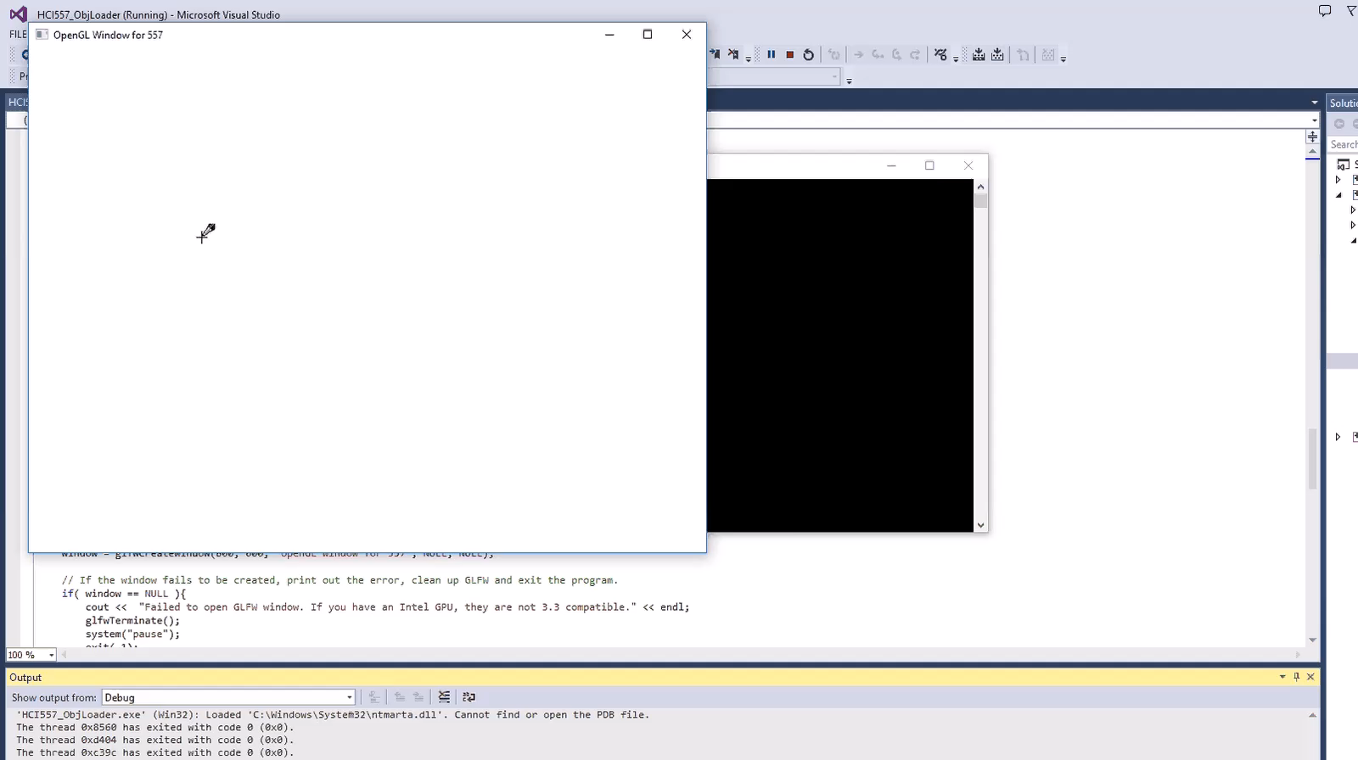
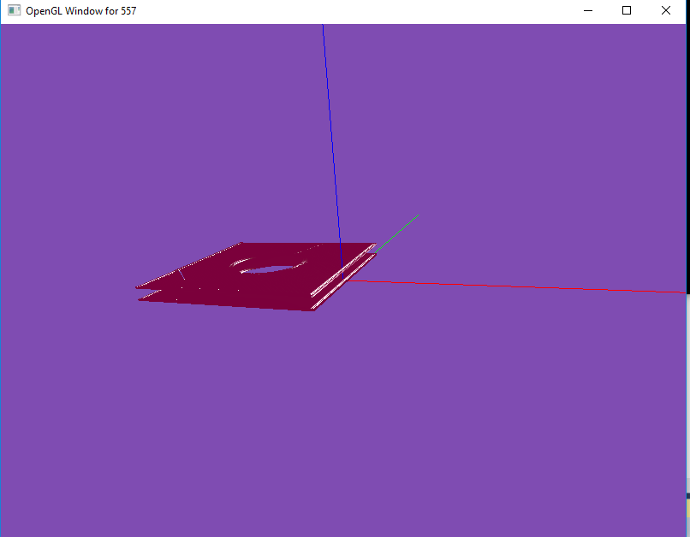
STEP 5
Current Stage
Arrange layers on top of one another and assign Key combinations to control the motion of the layers
Key Control using U -> for Up and J -> for Down function.
Currently working on adding more layers and their animation (translation/rotation).

Slide 12
Future Work
Add all the layers and their control.(Hierarchical Models)
Make the layers stick to one another.(Ray Intersection)
Build an environment and assign textures to the whole scene.
Assign Camera controls to zoom and view the layers.
Repeat all these steps and make different layer by layer models.

Slide 13
Thank You

